Slide 1
Internet services in the work of university teacher
Alexey Kozlov
Akozlov@mesi.ru

Slide 2
Research
The purpose of the survey was to get an answer to questions such as: how deep the teachers are engaged in the use of advanced Internet services including web 2.0, whether they accept these services in a professional activity or not.
Total number of respondents were 209 tutors and 97% of them responded to the first question as follows: "Several times a day," which has already shown high activity of teachers in the use of Internet services in general.
https://www.google.ru/

Slide 3
List of questions
"How often do you use the Internet?"
"For what purposes do you use the Internet?"
"What resources do you use in your professional work?"
"What resources do you use for personal purposes?"
"Specify the types of services that you would like to use?"
"How can you use blogs and websites in a professional activity?"
"How do you feel about participating in professional societies?"
"Do you use professional community during the work with students?"
"Do you use social media in the learning process?"

Slide 4
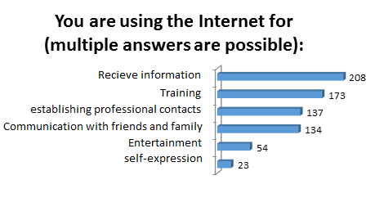
Very important result of the survey was to obtain a response to second question. 82% of respondents pointed that they use web 2.0 services for learning, that means only one thing: the majority of teachers are information seekers and use modern Internet resources to develop themselves as a professionals.

Slide 5
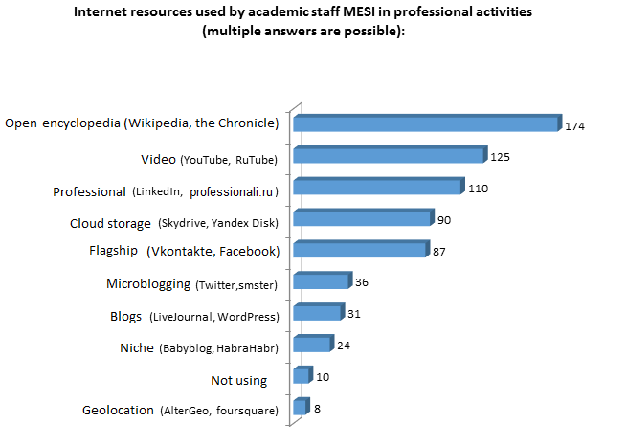
Notes:
Main feature of Internet services is that a professional interest in using of web 2.0 quite often coincides with the personal interest: spending time in Facebook teacher is not only talking with friends, but also discussing different questions in professional societies, receiving relevant and useful information on their discipline, so respondents answered the fourth question same as the third.

Slide 6
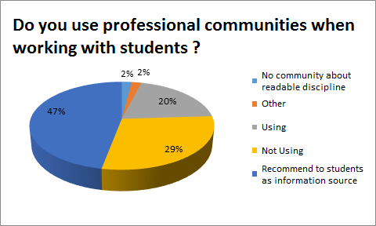

Slide 7
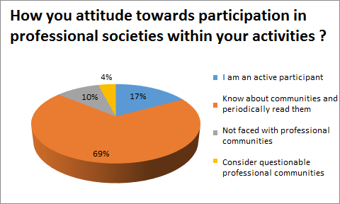

Slide 8
Last question of the survey was about using of Internet services in 2014, concerned the use of social networks in the learning process
40% of respondents reported that they use them.
Second place was shared by two opposing views: 23% of teachers want to try to use them in the learning process, while 22% do not see any sense.
Truth is, most likely somewhere in the middle: there are disciplines that can effectively use social media in the learning process, bringing together students and point them to group tasks in Facebook with elements of the games, while for other disciplines more suited case or personalized with personal discussion in the classroom
In addition, the majority of teachers reported that set of LMS MESI functions satisfy their requirements around the group work with students instead of using social networking as it relates to the additional time for authorization and information search, whereas LMS MESI all clearly structured.

Slide 9
Thank you for your attention!
Akozlov@mesi.ru

