Slide 1
How Testing is Changing in the 21st Century
Presented by
Don Kassner –
President, ProctorU

Slide 2
Growth in online education
5.5 million
http://www.onlinelearningsurvey.com/reports/gradechange.pdf
http://chronicle.com/blogs/wiredcampus/exactly-how-many-students-take-online-courses/49455
Notes:
According to a widely-cited 2014 Babson Research Survey Group, entitled “Grade Change: Tracking Online Education in the United States,” over 7.1 million students are now taking at least one online course. The National Center for Education Statistics has since begun tracking online-enrollment figures after the Education Department required colleges and universities to report data, beginning in 2012.
In 2012, according to the department, 5.5 million students took at least one online course.
Discrepancy – Slightly differing opinions on definition of what a distance education course is and some colleges are “not properly accounting for the multiple counting of students taking more than one online course” in the figures they provide to Babson. Since the education department started requiring colleges to report distance education enrollments, Jeff Seaman (co-director of Babson, Grade Change co-author) says those institutions have probably become more exacting in their tracking of those numbers.
A lot of these “U.S” students come from out of the country, as we’ve seen at ProctorU.
For Fall 2012, out of 7,764 US institutions, 33,666 students were enrolled exclusively in distance education courses were located outside of the United States (at all levels – under grad, grad, etc)

Slide 3
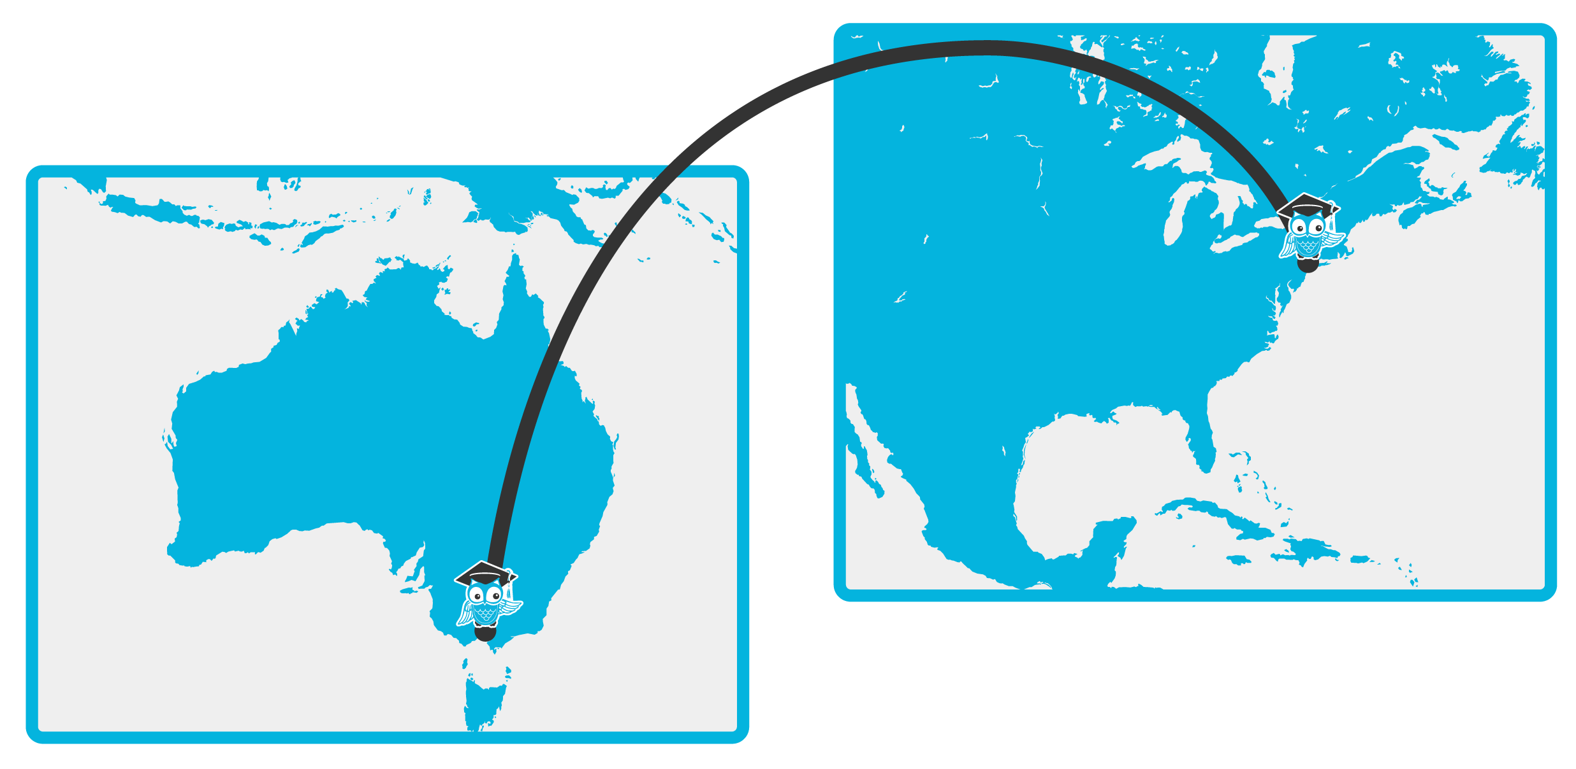
How can you be sure?
Notes:
How can you be that the person that signed up for the course is the person that showed up for the exam?

Slide 4
Approach
Various models
Testing centers
Live online proctoring
Record and review
Authentication only
Secure browsers only

Slide 5
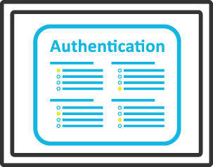
Authentication tools
Photo identification
Government-issued
Challenge-based questions
Used by the banking and healthcare industries
Biometric analysis
Keystroke, facial and handwritten

Slide 6
Questions?

