Slide 1
Martin H. Andresen
@mandresen

Slide 2
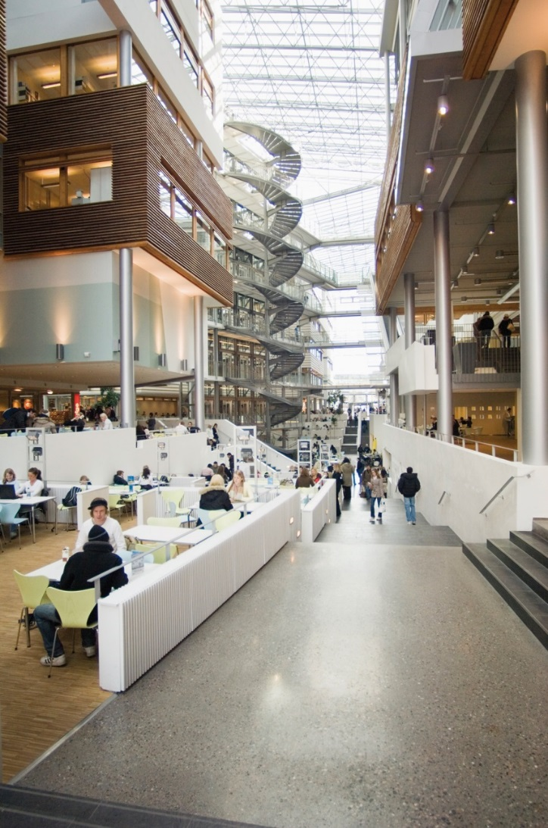
About BI
internationally recognized not-for-profit private institution
20.000 students
over 1200 international students.
eight separate departments
with 26 research centers
dedicated to business administration, marketing, ﬁnance and general management.
830 employees
417 academic staff

Slide 3
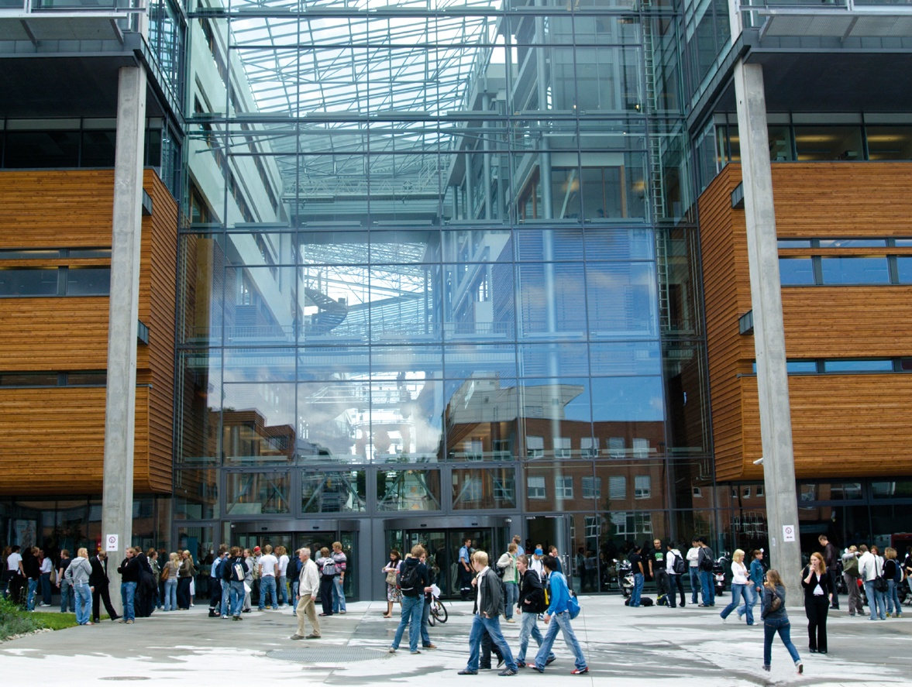
The Learning Intensive Society
Micro Learning Concepts
Smartphone
emergence
Project
demo

Slide 4
Meso
Macro
Micro

Slide 5
How can we use
in a learning context?

Slide 6
Micro Learning
Learning is broken down into fragments:
Extremely short and focused
Minutes & seconds
Keywords & headlines
Distributed environments

Slide 7
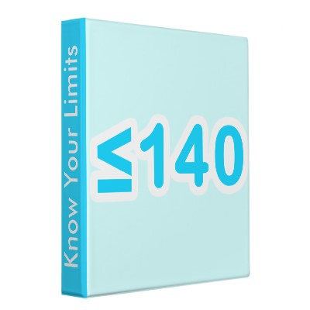
Think Twitter
Amount of information is restricted
Forces authors to focus content
More predictable and easy to digest for the receiver

Slide 8
Micro Learning vs. Traditional Learning

Slide 9
The Learning Intensive Society
Micro Learning Concepts
Smartphone
emergence
Project
demo

Slide 10
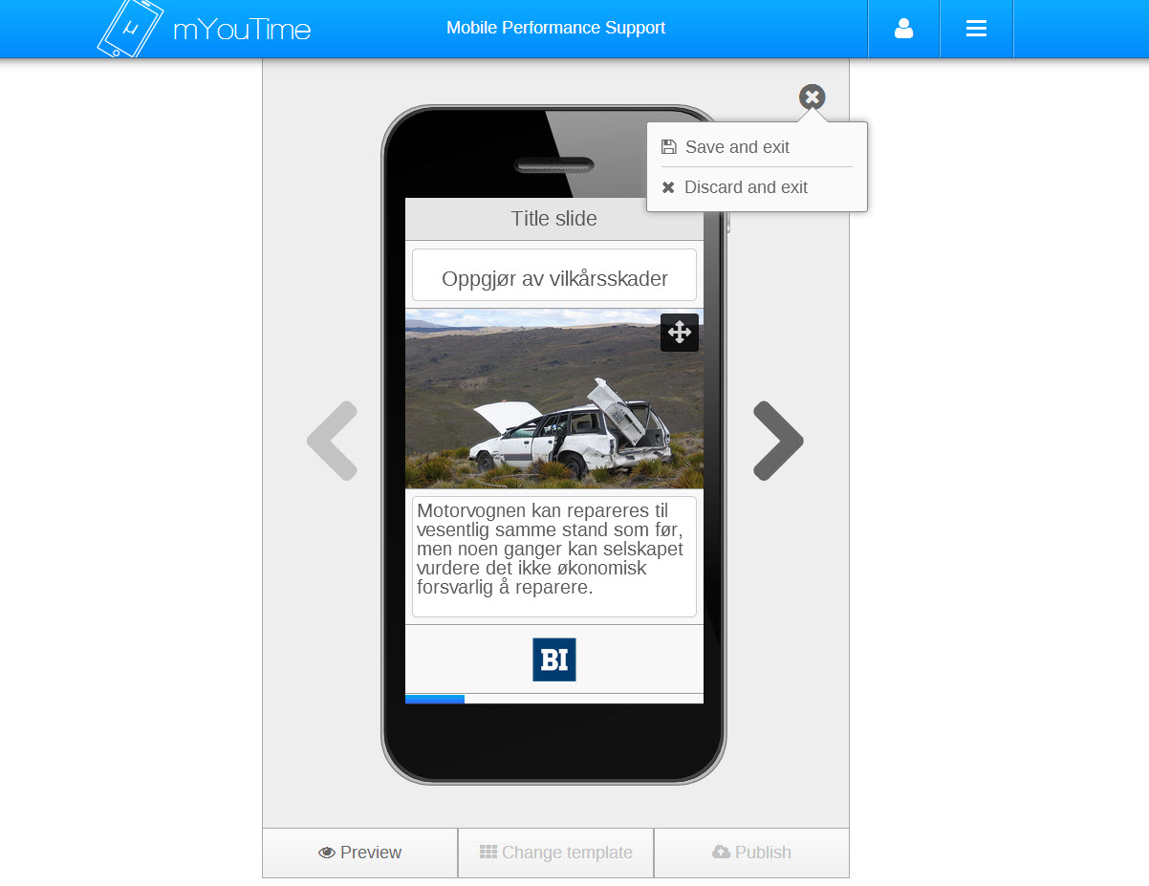
The mYouTime-project
Banking and Insurance studies
Target group: executive students
Blended learning-approach

