Slide 1
SPEAK UP!
Enhancing e-learning with social learning

Slide 2
Introduction
PANDORA
Manufacture, market and sell handfinished, high-quality jewelry at affordable prices
11,000 employees including 7,800 in production facilities in Thailand
9,800 points of sale across more than 80 countries
Owned-and-Operated, franchisees, distributors, multi-branded stores
Training as sales support function

Slide 3
The challenge
OBJECTIVE: To facilitate learning around products, and how to sell them, to enables sales staff to maximize sales and secure a positive customer experience.
TARGET AUDIENCE: Around 30,000, 18-25 y.o. female learners, highly diversified (culture, language, employer, previous experience, educational background, geography), high turnover
BUSINESS REQUIREMENTS: New product cycles every 2 months, non-performing products regularly retired, high growth environment = high expectations to performance

Slide 4
THE SETUP
Extensive, global e-learning program to support product and sales training.
Processes to cover to storyboarding, approval, translation, validation, publication and reporting
Supported by local, both formal and informal face-to-face training activities
LCMS: eXact Learning Solutions LCMS
Rapid Authoring: eXact Learning Solutions Packager
LMS: Cornerstone OnDemand
Translation: XLIFF formatted files to language vendor

Slide 5
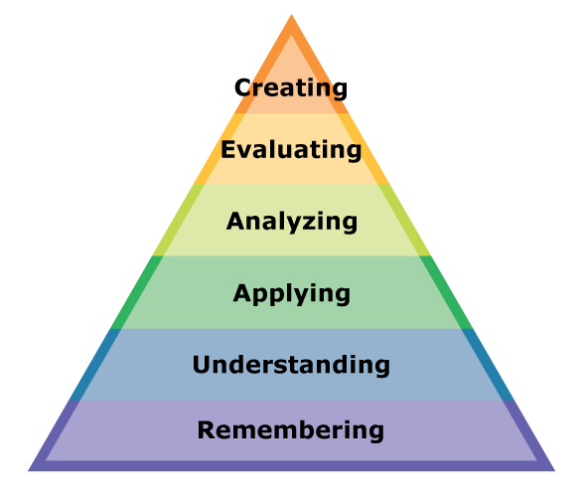
The project
To investigate whether it is possible to enhance learning value of existing e-learning program by allowing the learners to create their own knowledge using social learning?
Bloom’s taxonomy

Slide 6
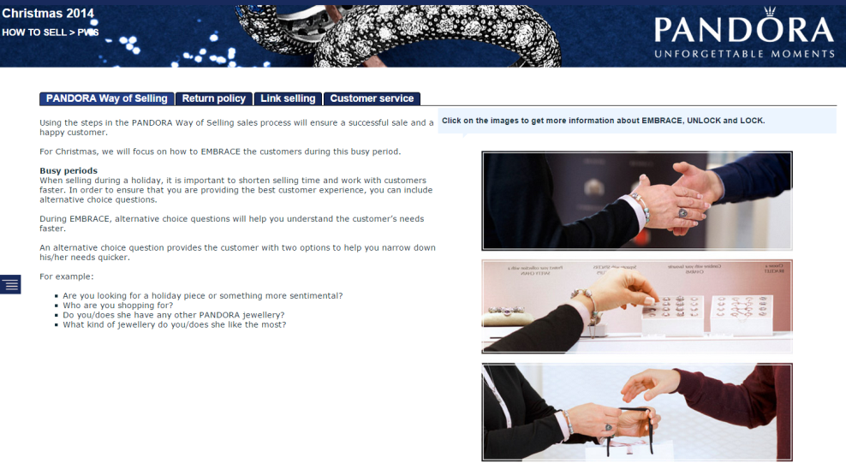
Existing e-learning
Point-n-click with text and product images, marketing videos
Multiple choice, drag-n-drop quizzing
Open-ended questions unavailable due to lack of resources
Mostly engages the users at the first level ”remember”, or at best the second level ”understand”

Slide 7
Proposed solution
Add open-ended questions into e-learning modules, which then links to relevant contextual forum in social learning environment (HTML href tag)
Involve local business unit in deciding which questions to ask
Let co-learners ”grade” the responses
Pilot test in UK (+3,000 learners) started June 2014

Slide 8
Results
Social learning platform UI/UX challenges..
Learners have a way to construct knowledge during their online training activity, and share that knowledge with other learners, and learn from and be inspired by each other
Learners are ”talking”
Learner engagement: Started at 9%, currently at 39%
Zero negative, insulting, offensive postings

Slide 9
THANK YOU! ☺
@pferdinandsen

