Slide 1
We Have a Winner! Faculty Build/Faculty Teach Trounces Instructional Designer Build/Faculty Teach By Dr. Tamara Powell Director, College of Humanities and Social Sciences Office of Distance Education, Kennesaw State University, Kennesaw, Georgia, USA

Slide 2
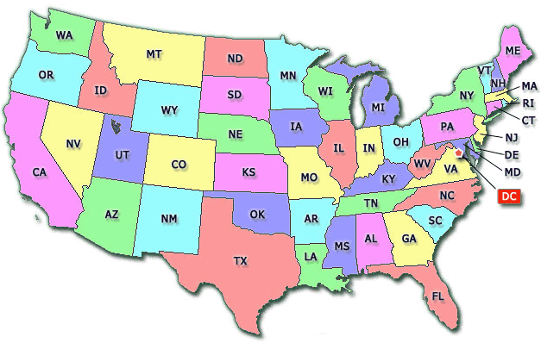
Where is Kennesaw State University?

Slide 3
Overview/Context
KSU established in 1963
30,000 students
No space
469 weblearners
5,092 seats in hybrid/blended
courses
10,730 seats in online courses

Slide 4
Overview/Context
9 colleges
Humanities and Social Sciences
Business and Computers
Health and Human Services
Education
Arts
Science and Math
Etc.

Slide 5
Overview/Context
Online at KSU
QM standards (43 research-based standards of “Best Practice”)
All online courses must pass a peer review process before being offered
Federally mandated interaction

Slide 6
ID Build/ Fac Teach vs. Fac Build/Fac Teach
Instructional designers: Trained in designing effective information delivery.
I instructional designers!
Faculty: Often not trained in designing effective information delivery. Have teaching and research experience and broad view of the discipline.

Slide 7
ID Build/Faculty Teach
Strengths—cheaper and faster
Weaknesses—IDs are not content experts, seems as if courses are not as rich and faculty are not as invested in courses, so don’t update and reteach them (more research needed)

Slide 8
Faculty Build/Faculty Teach
Weaknesses—more expensive and time consuming (must train faculty to create online courses)
Strengths—richer content, faculty more invested in teaching and updating course, faculty bring broader disciplinary view to courses.

Slide 9
In Conclusion (Number of Courses, 2009-2014)

Slide 10
In Conclusion--More
Clear winner in terms of quantity: The consistent, sustained building and teaching of online courses comes from the faculty build/faculty teach model.
No question from the data that the model we are using in our college, which some in our university advocate against, has led to more course creation.

Slide 11
In Conclusion—More and Better
Tentative conclusion, pending future research is that faculty build/faculty teach is a winner in terms of quality, as well.
I have served as a reviewer of courses across the college. It is my strong impression that, on average, these faculty designed courses are superior to instructional designer created courses.

Slide 12
Thank you!
Questions?

