Slide 1
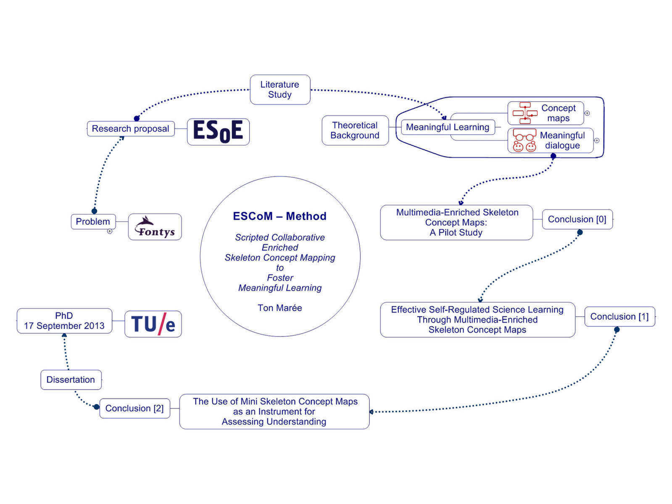

Slide 2
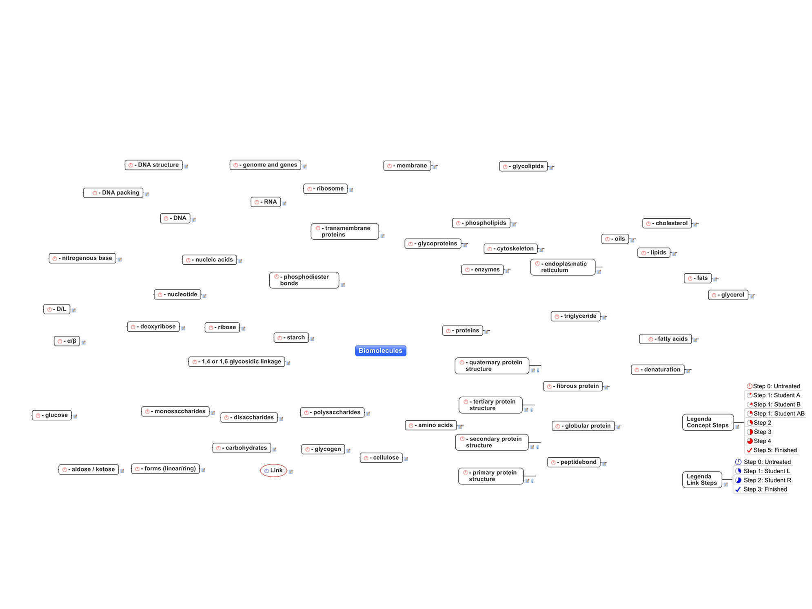

Slide 4
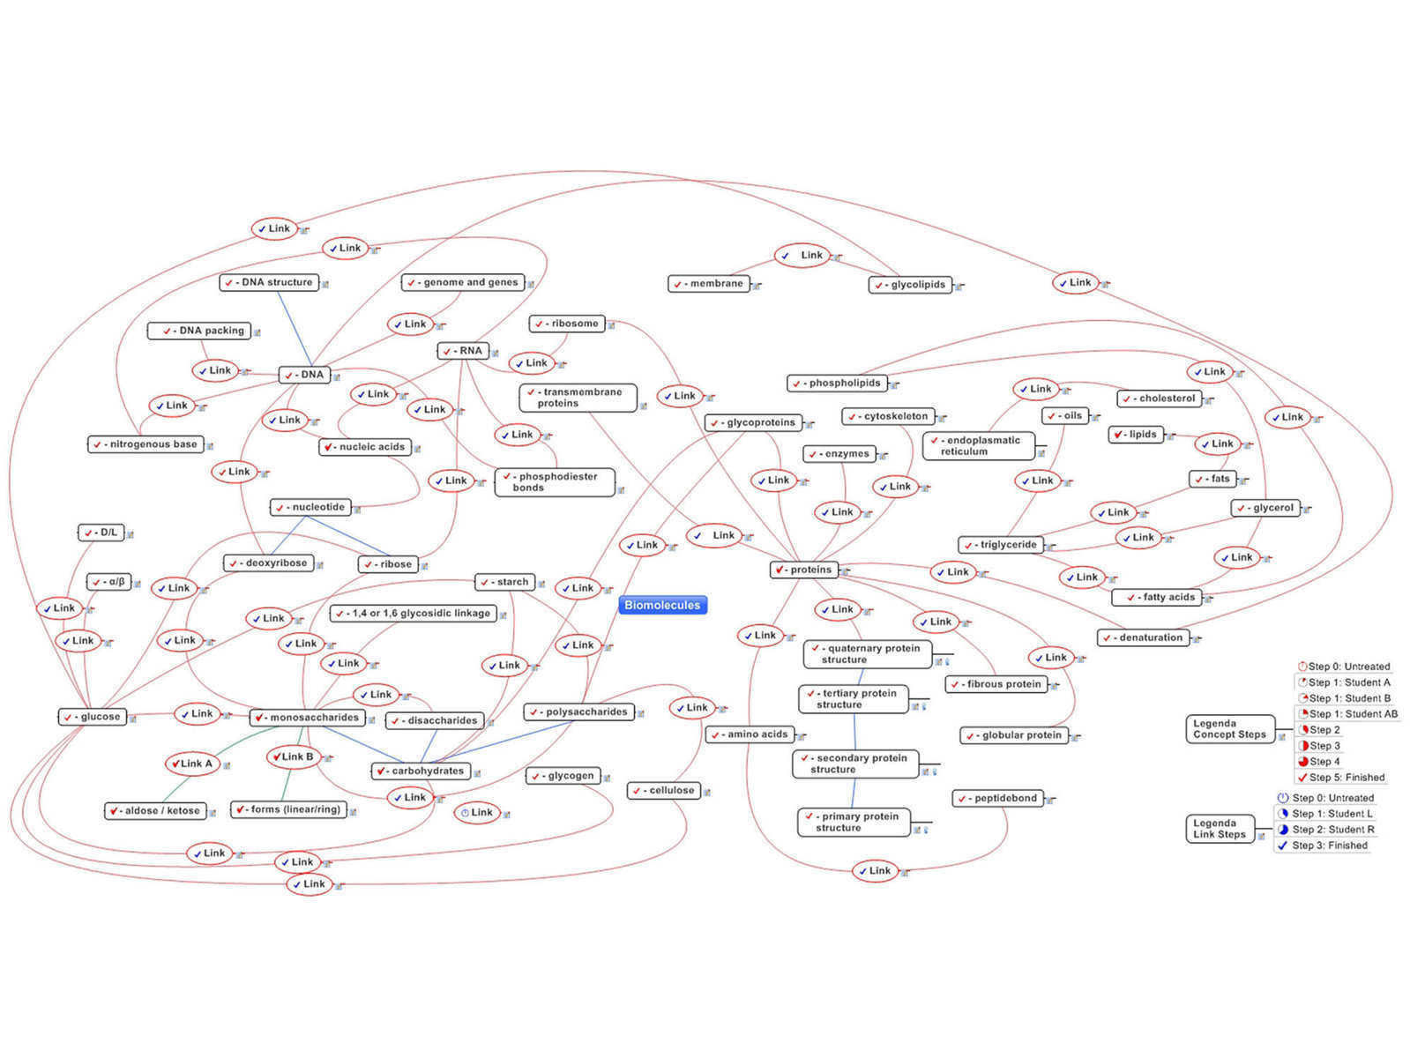

Slide 5
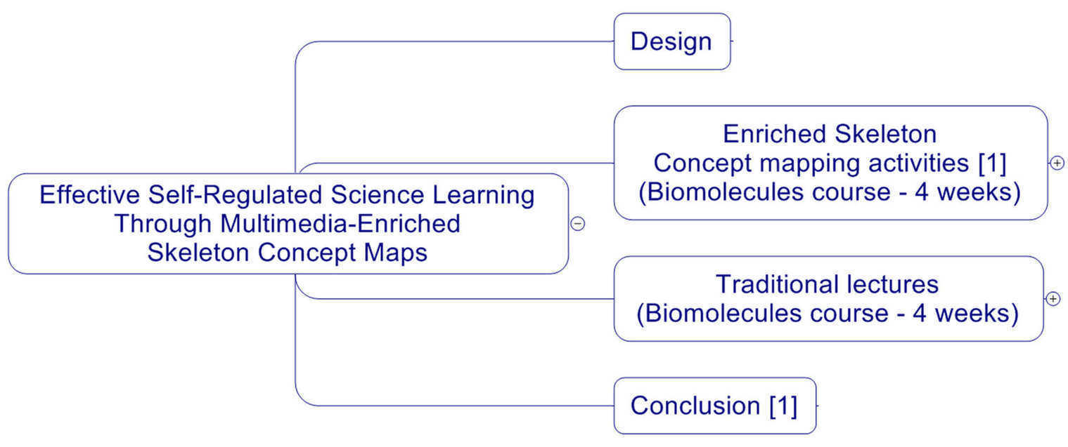

Slide 7
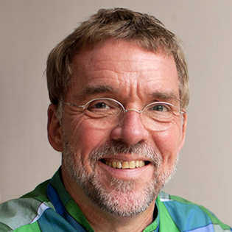
Ton Marée
I thank you, for your attention.
Dissertation: Scripted Collaborative Enriched Skeleton Concept Mapping to Foster Meaningful Learning. http://issuu.com/tonmaree/docs/scripted_collaborative_enriched_ske
E-mail: a.j.maree@tue.nl
Profile: http://nl.linkedin.com/in/tonmaree

