Slide 1
ePortfolio Work with Students in the Field of Information and Business Technologies
eLearning Centre of the Flensburg University of Applied Sciences, Germany

Slide 2
Competency based principles
Shift from Teaching to Learning
Competency based learning
Reflective learning via portfolio
Page 2/15

Slide 3
ePortfolio work
Students in the field of information and business technologies
Constructive alignment
Empirical study
Impact on reflective learning
Lessons learned
Page 3/15

Slide 4
Enterprise Architecture
University of Applied Sciences Flensburg and JKUAT
Seminar
Architecture of:
Business
Information
Data
Technology
Learning Outcomes:
Knowledge of methods to optimise Enterprise Architecture
Ability to plan IT applications
Page 4/15

Slide 5
Data Science
University of Applied Sciences Flensburg, JKUAT and Polytechnic of Namibia
Student project
Dashboard for investors:
Interactive facts and
Figures on the existing data from World Bank
Learning outcomes:
Knowledge and
Application of business intelligence technologies
Page 5/15

Slide 6
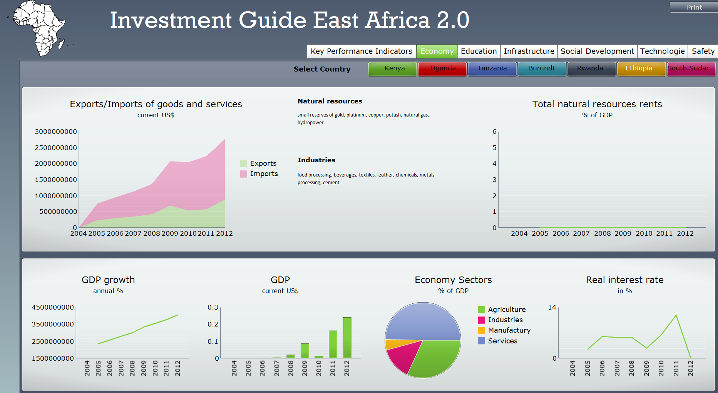
Data Science - Example
http://www2.wi.fh-flensburg.de/africancentre/wp-content/uploads/2014/11/EastAfrica_2014_11_13.swfn
Page 6/15

Slide 7
Portfolio work
Future collaboration
Learning journals
Expectations
Page 7/15

Slide 8
Centre for Business and Technology in Africa
Page 8/15

Slide 9
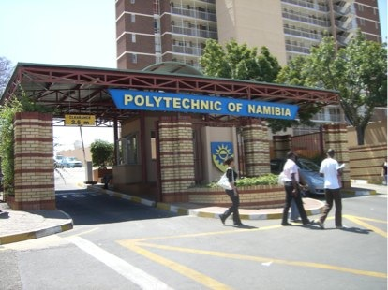
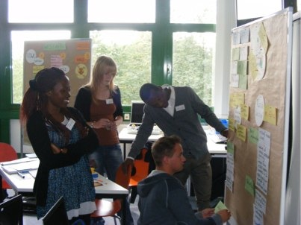
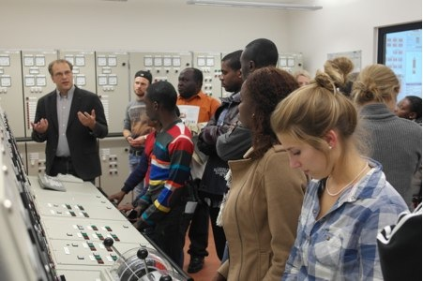
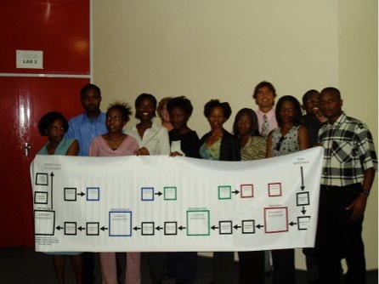
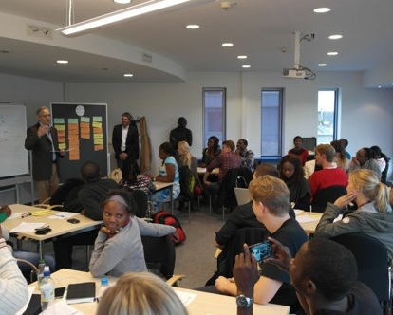
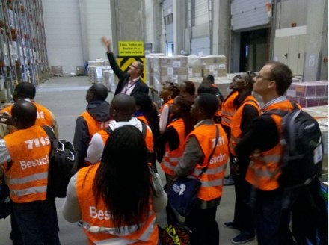
Centre for Business and Technology in Africa
Study Programmes
in Africa
Modules in Germany
Autumn/Spring
School
Page 9/15

Slide 10
Centre for Business and Technology in Africa
Autumn School in Flensburg
Page 10/15

Slide 11
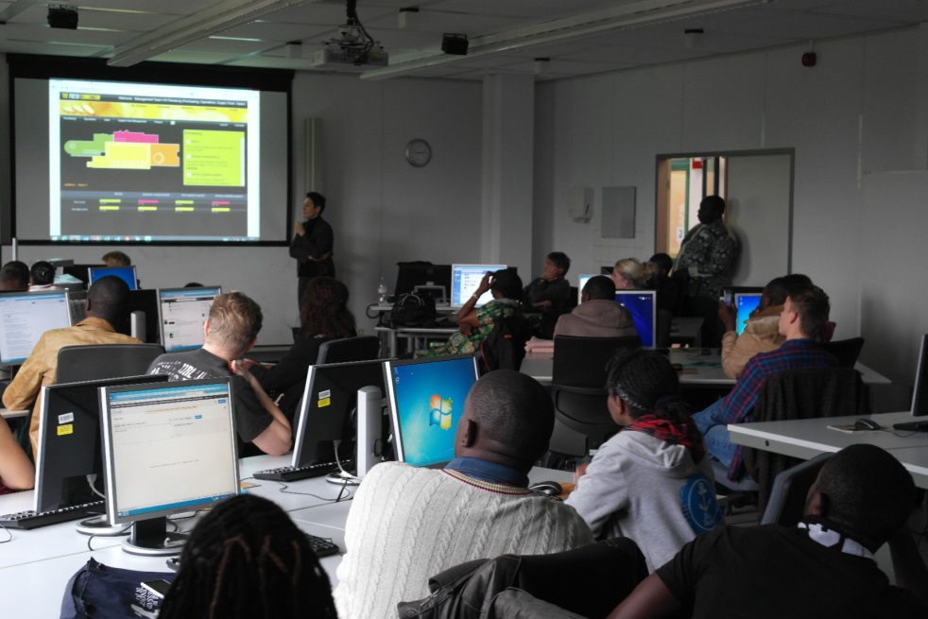
Centre for Business and Technology in Africa
Study Programme
in Cameroon
“Business in Africa“ in Flensburg
Page 11/15

Slide 12
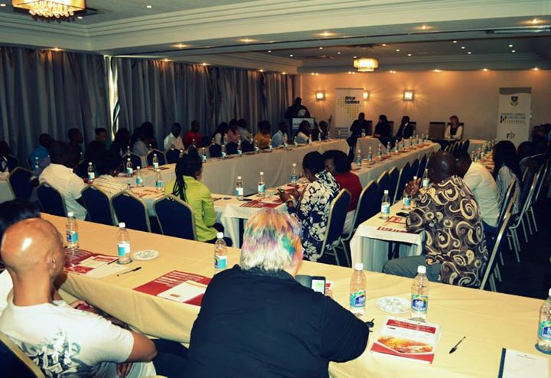
Centre for Business and Technology in Africa
Training and Workshops – Conference in Walvis Bay
Page 12/15

Slide 13
Centre for Business and Technology in Africa
Autumn School in Flensburg
Page 13/15

Slide 14
Centre for Business and Technology in Africa
Spring School in Cameroon
Page 14/15

Slide 15
Centre for Business and Technology Africa
Contact:
http://www.africacentre.de
Page 15/15

