Slide 1
What a difference a year makes:
Introducing reflective, flexible and lifelong learning opportunities in Sports
Lucy Stone
E-Learning and Resource Development Manager

Slide 2
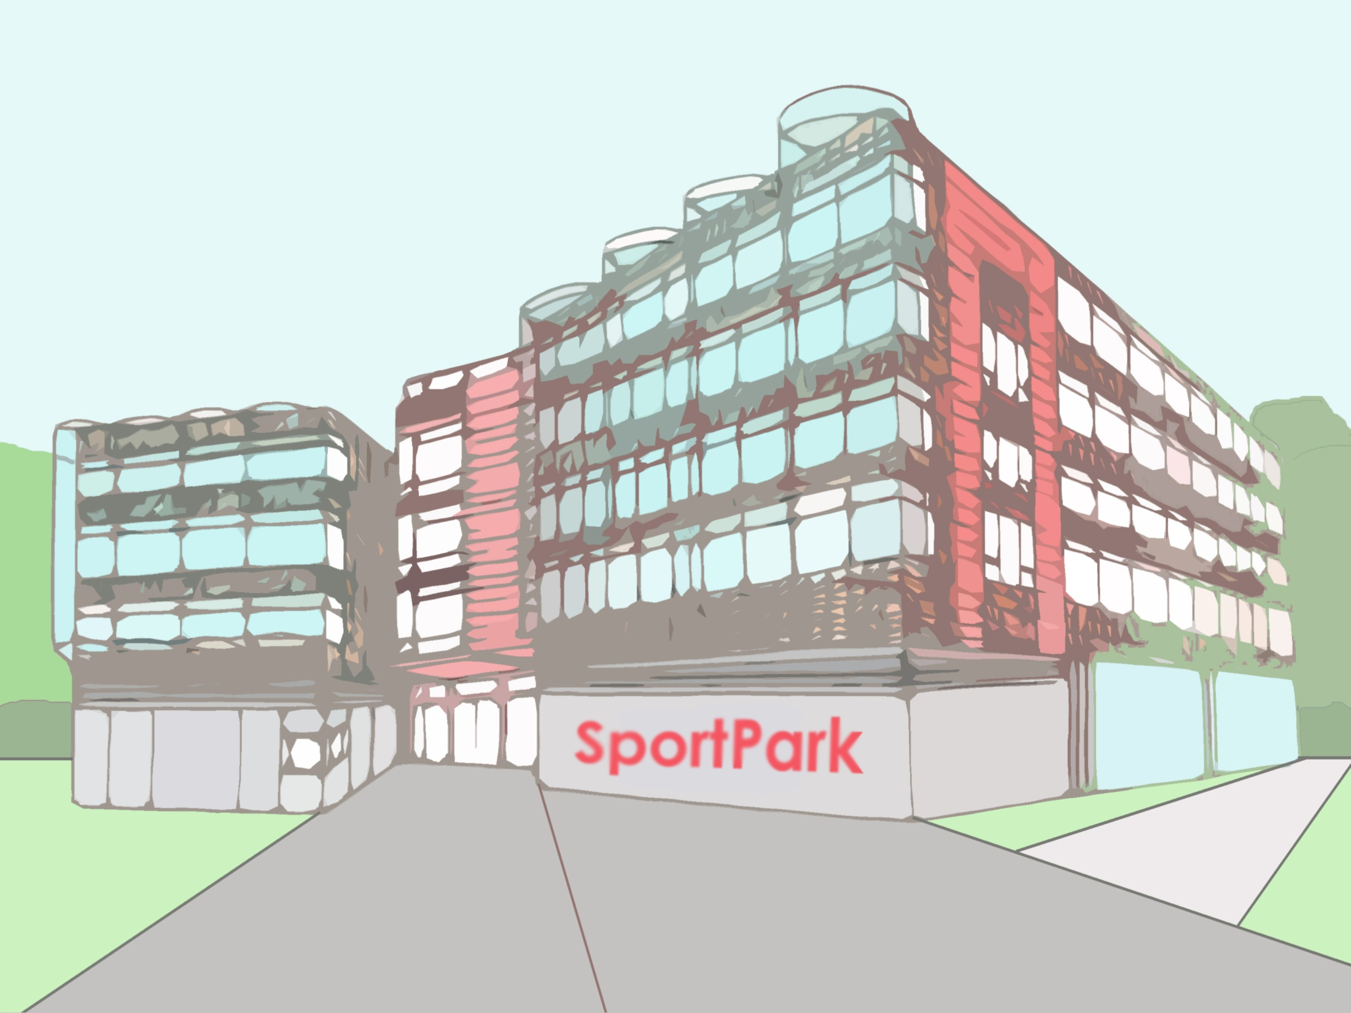
British Swimming
Amateur Swimming Association
The Institute of Swimming

Slide 3
British Swimming
350 staff
8 regions around the UK
Identifying new talent
Organising our elite athletes
Supporting clubs

Slide 4
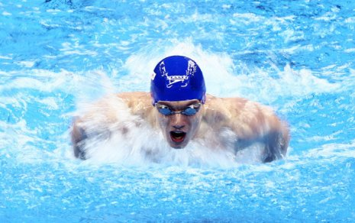
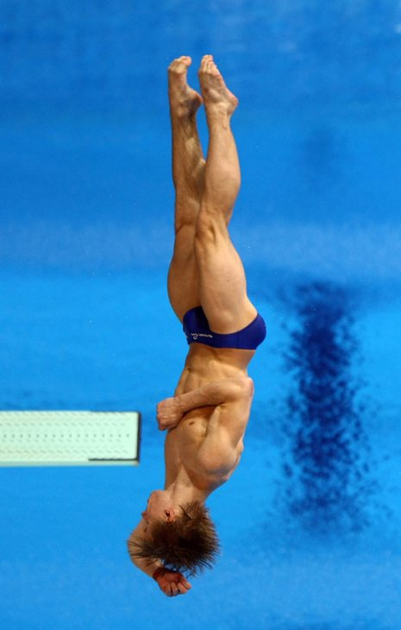
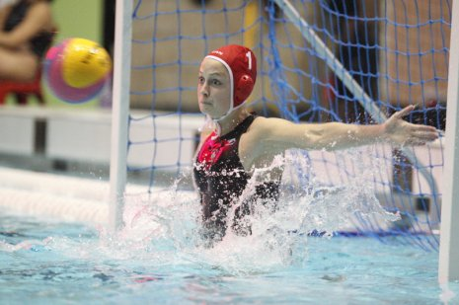
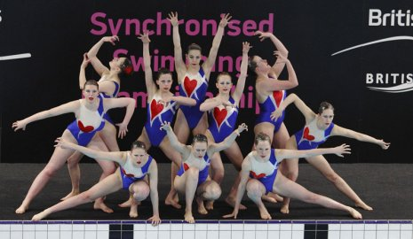

Slide 5
The Amateur Swimming Association (ASA)
National Governing Body
The awarding body – started 1869
ASA Approved Centres – 27 of which 6 are overseas
ASA Licensed Tutors – 160

Slide 6
The Institute of Swimming (IoS)
The IoS is our main training provider
Providing in excess of 70% of the courses
17,000 learners on the system
120 of the 160 licensed tutors
Run by approximately 40 staff
Quality assurance of a college
Notes:
Course provision:
Where you would go if you want to become a swimming teacher, a diving coach, synchro coach or water polo coach.

Slide 7
Notes:
A little bit like a college, but in the same building as the awarding body.

Slide 8
Course offer
Teaching or Coaching pathways
Level One (Support Teacher or Assistant Coach)
Level Two (Teacher or Coach)
Four disciplines – Aquatics/Synchro/Diving and Water Polo
Level three and four
Level One = 5 days to Level Three = 3 years
In excess of 50 professional development courses
Over 400 Apprentices – rapidly growing
Predominantly work based learners

Slide 9
Issue One
Issue Two
Issue Three

Slide 10
Issue One: Where is reflection?
“reflect on”...
What happens next?
Is reflection naturally occurring?
Notes:
Teaching and coaching courses ask all the time for the learners to Reflect on their practice, yet we were not offering any opportunity for the learners to reflect
What happens after a CPD face to face seminar?
Building on previous research from a project called “Keeping Warm” – how can we improve retention of learners over the summer – Blogging activity tied in with using Gibb’s reflective cycle and gaining and understanding of reflective writing and thinking

Slide 12
Issue Two: Building a community
How do we encourage people to become lifelong learners?
Building on previous JISC research projects:
Work Based Learners in Further Education (WoLF) Project
Higher Education Lifelong Learning Opportunities (HELLO) Project
Encourage learners to become part of a community of practice
Notes:
Tutor led discussion forums to enable learners to become part of a community of practice, help them with their identity as a learner and hopefully lead to a culture of lifelong learning.

Slide 13
Issue Two solution: ATLAS
Active Teaching, Learning and Assessment Space on PebblePad
Interaction with peers, tutors and like minded people
Community element

Slide 14
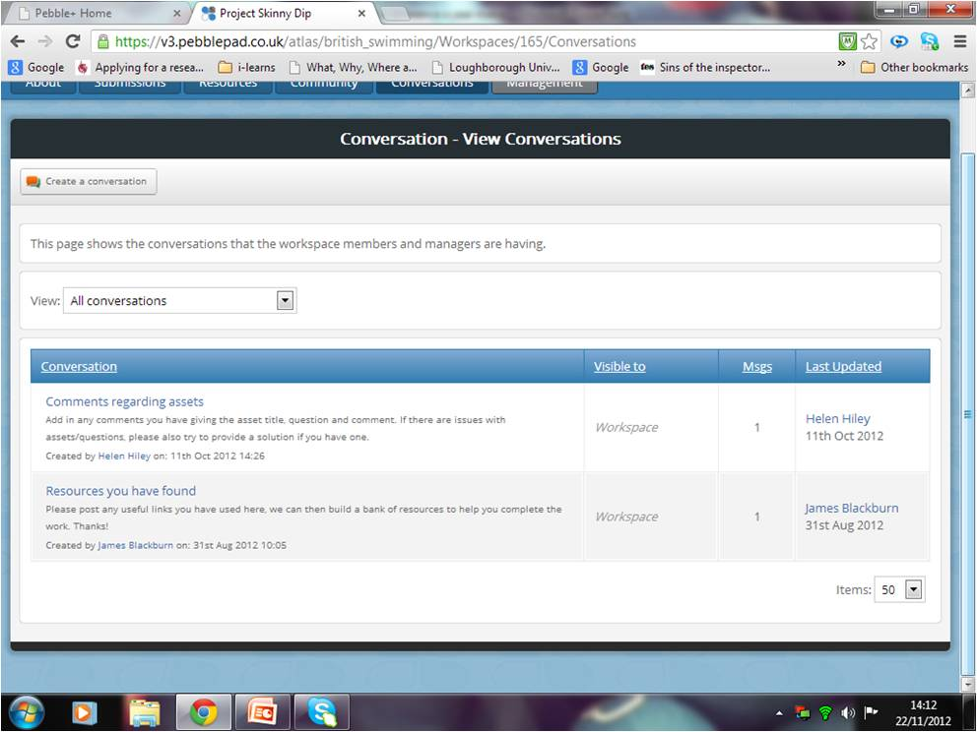

Slide 15
Issue Three: Offering flexible learning
Traditional delivery
Work based learners
Paper based
Portfolio driven
Mix of theory and practical
Notes:
Face to face courses
Large amounts of workbooks and paperwork, filling out 200 disparate bits of evidence in a paper based portfolio
Learners already working in the environment

Slide 16
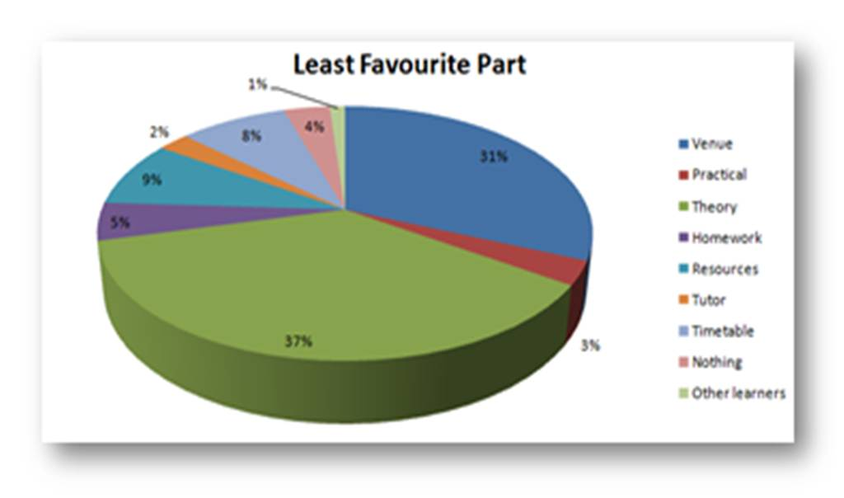

Slide 17
Issue Three solution: i-Learns
Break down qualifications into bite sized chunks
Theory offered at home
Use a ‘games’ approach to development of the materials
Introduction of additional materials to support teachers and coaches in becoming “High Performing”
Notes:
Offered theory as online learning
Combination of gathering evidence in the ATLAS space
Still with tutor intervention
Important to keep the educational integrity of what we do and ensure that the learning experience is of value
Use creative art work, scenarios to put the learning into context whilst working online

Slide 18
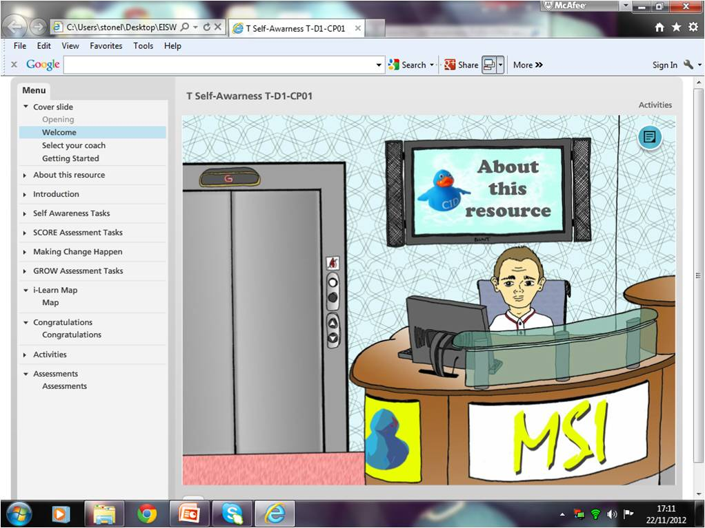

Slide 19
Lucy Stone
British Swimming
SportPark
3 Oakwood Drive
Loughborough
Leicestershire
LE11 3QF
Tel: 015090 640 770
Email: Lucy.Stone@swimming.org
Skype and Twitter: lucyrstone

