Slide 1
Investigating the Effects of Training and Techno-Pedagogical Support
University of Liège, IFRES
Béatrice Lecomte
Jeff Van de Poël
Patrick Schaffer
Dominique Verpoorten
Online Educa Berlin 2013

Slide 2
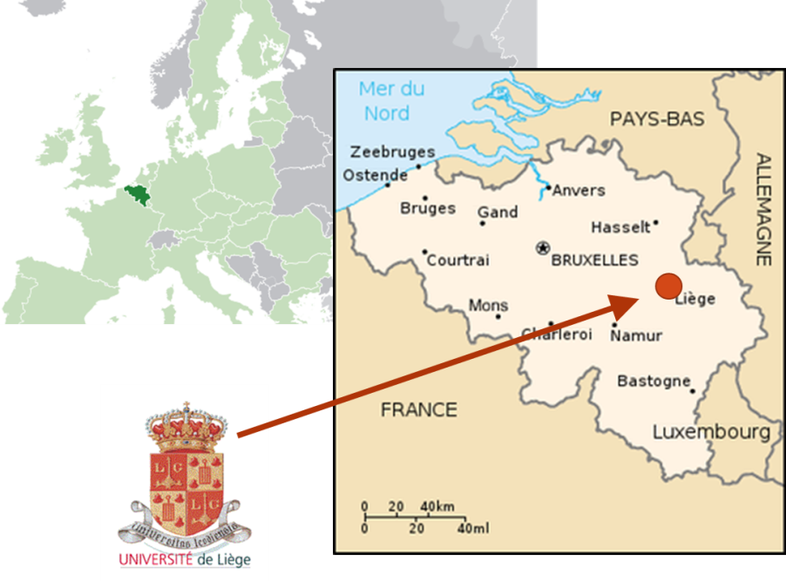
The University of Liege (ULg), Belgium
Public complete university
Founded officially in 1817
10 schools, 1 institute
3,300 professors and researchers
21,000 students
IFRES (2005): promote and develop Higher Education

Slide 3

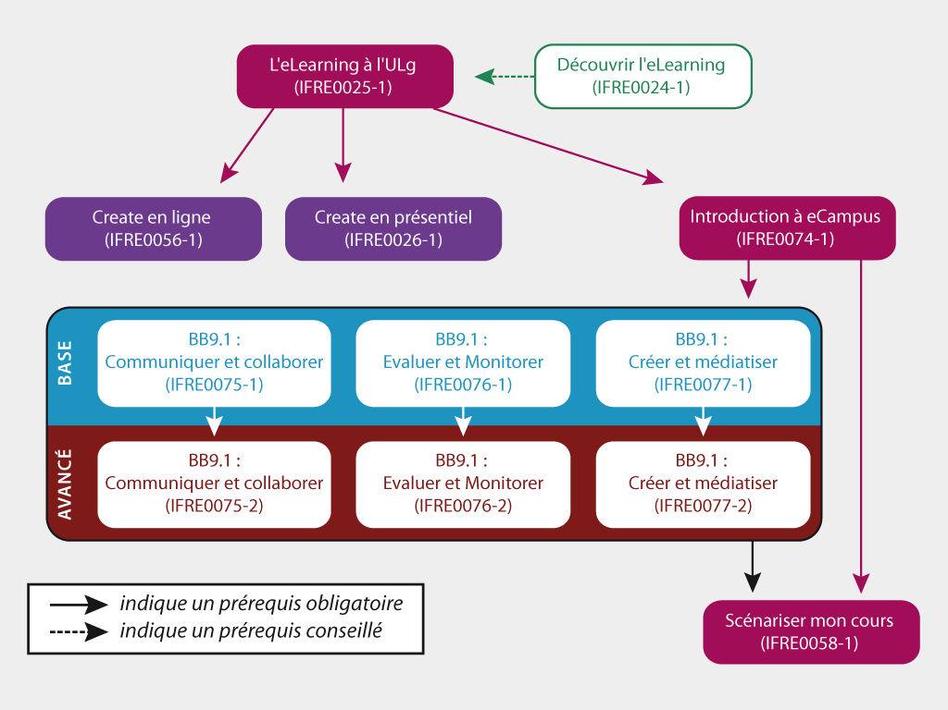
Mandatory trainings for new academics & TAs…
eLearning sessions
Notes:
Held by the IFRES (Institute for Training and Research in Higher Education – 2005)
Who ? New academics and teaching assistants
10 credits (1 = ½ day)
65 different training around pedagogy and teaching
11 focused on eCampus (eLearning)

Slide 4
Do these eLearning sessions motivate academics and TA’s to integrate ICT into their teaching practice ?

Slide 5
Enrollments & participants /year
Enrollments
Participants
Notes:
2/3 proviennent des facultés de Médecine, Médecine VT, AgroBioTech, Sciences et Sciences appliquées

Slide 6
Status (N=225)
Academics
Teaching Assistants
Others

Slide 7
Distribution by school (N=225)

Slide 8
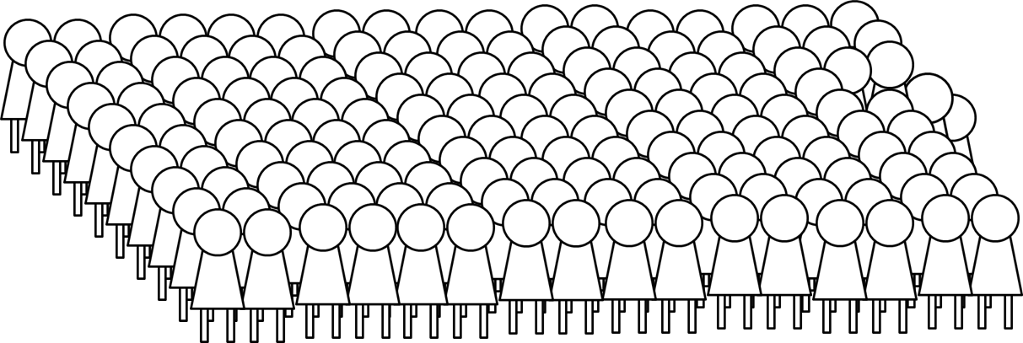
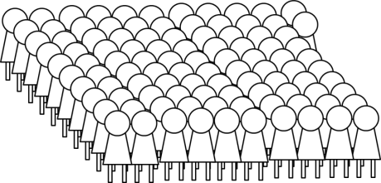
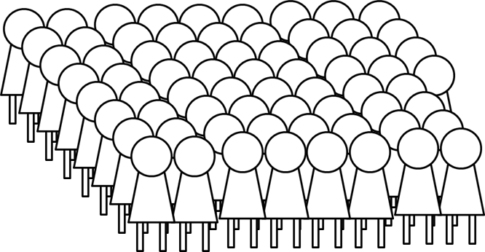
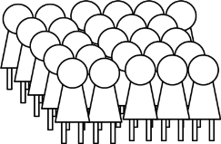
Enrollments to eLearning sessions
eLearning at ULg
165
Introduction to the platform eCampus
102
eCampus basics (contents, communication, assessment)
68
eCampus advanced (collaboration, monitoring)
26

Slide 9
Satisfaction survey : results
9 items – Likert scale + comments
High satisfaction (>80%, mostly >90%)
  Learning methods
  Interactions
  Quality of answers
  Good overview
  Practice
To be improved
  Time management
  Huge amount of info

Slide 10
Impact on technopedagogical development
Expressed
56 reflexive reports from attendees to eCampus sessions
44 mention eCampus
41 reports analyzed

Slide 11
Impact on technopedagogical development
Observed
Notes:
29% Academics
67% TAs

Slide 12
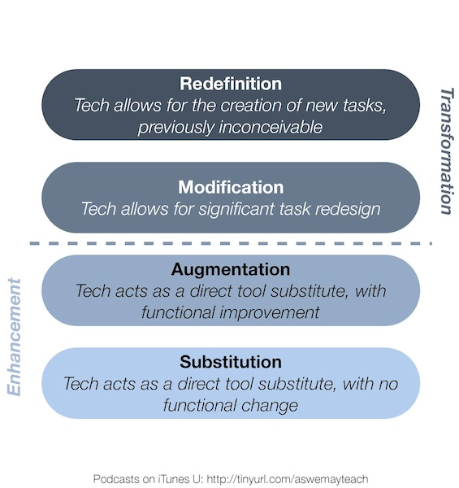
Categorization of the projets with SAMR model (Puentedura, 2009)

Slide 13
What’s next… it started already
Less prerequisites to attend any session
More and more online resources and showcases
Move sessions to schools
Improve visibility and communication about our services
http://www.ifres.ulg.ac.be/ecampus

Slide 14
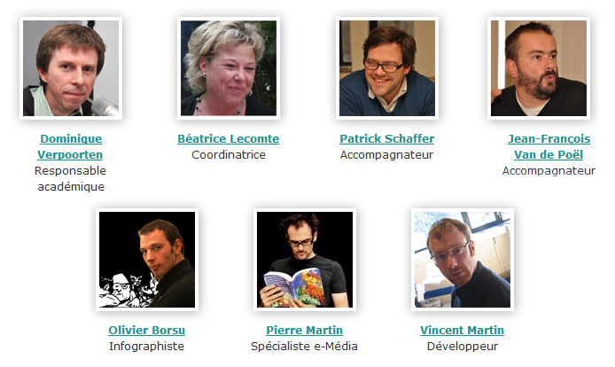
Thanks for your attention
http://www.ifres.ulg.ac.be/ecampus/

