Slide 1
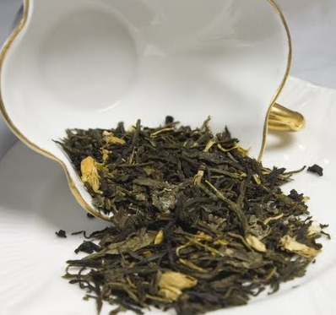
The complete learning environment
Hans van Bergen
Consultant Technology in Education
Utrecht University for Applied Sciences

Slide 2
Why Blended learning
Future focussed
Place independent and time flexible learning
Added value of F2F is more important
Powerful support of continous education

Slide 3
Blended environments
Local environment / F2F
Digital learning environment
Learning on the work spot
Learning with / from colleagues

Slide 4
Traditional lesson
Instruction
Assignments
Evaluation

Slide 5
Flipping the classroom
Instruction
Assignments
Evaluation
Digital
Digital / learning team
Contact time

Slide 6
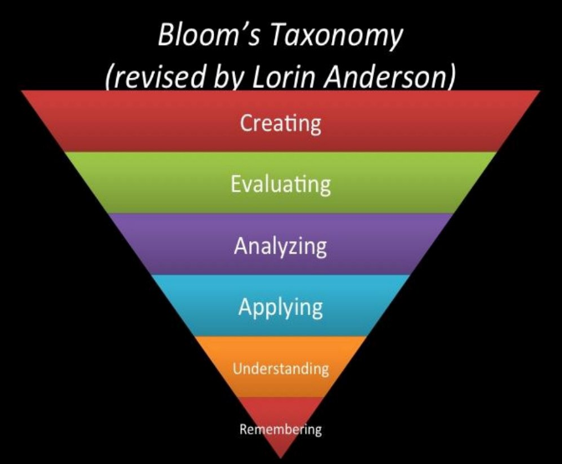
Flipping the Classroom
Instruction online
Deep learning and differentiation in the classroom; Higher learning skills

Slide 7
Strong points F2F
Direct contact
Social context
Benchmarking

Slide 8
Making choices
Choises based on own experience and expertise
Keeping in mind
Content
Pedagogy
Technological possibilities
Integration of these

Slide 9
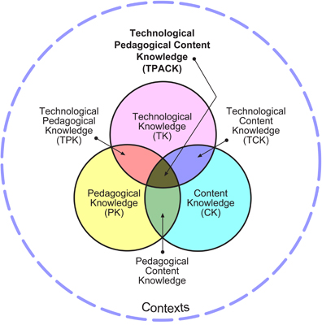
TPACK
Koehler & Mishra (2006):
We argue that at the heart of good teaching with technology are three core components:
Content,
Pedagogy
Technology
Equally important are the relationships between these three

Slide 10
TPACK
Koehler & Mishra (2006):
It is the interactions, between and among these components, playing out differently
across diverse contexts, that account for the wide variations seen in educational technology
integration.

Slide 11
Criteria for Continuous Professional Developpment at HU
Quality Accredited Intake and match | Connection with the professional field Partnership and co-creation Educating the professional field Professional field involved in quality control Applied research
Flexible redesign Stand alone units Certificate for single units Seperate Assessments Non consecutive courses | Pedagogy Self Directing for students Pedagogy for working professional Learning team learning Blended leren

Slide 12
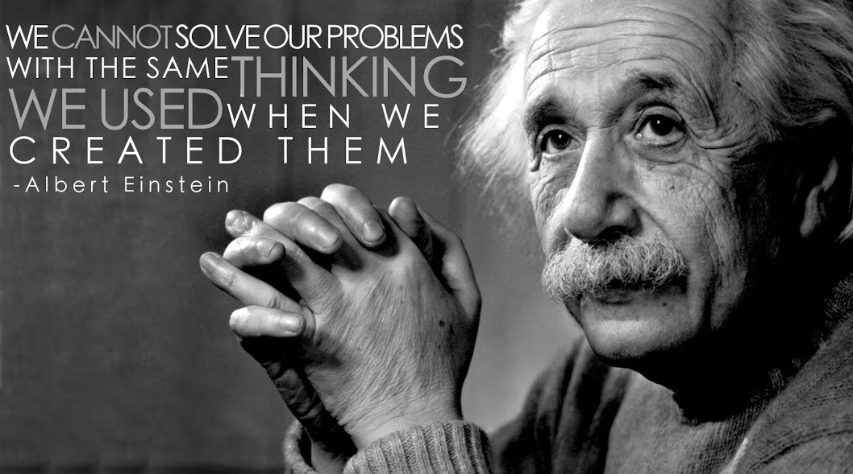

Slide 13
Translation to a platform
Dashboard
Content
Social context
Bench marking
Learning together
Integration of digital tools

Slide 14
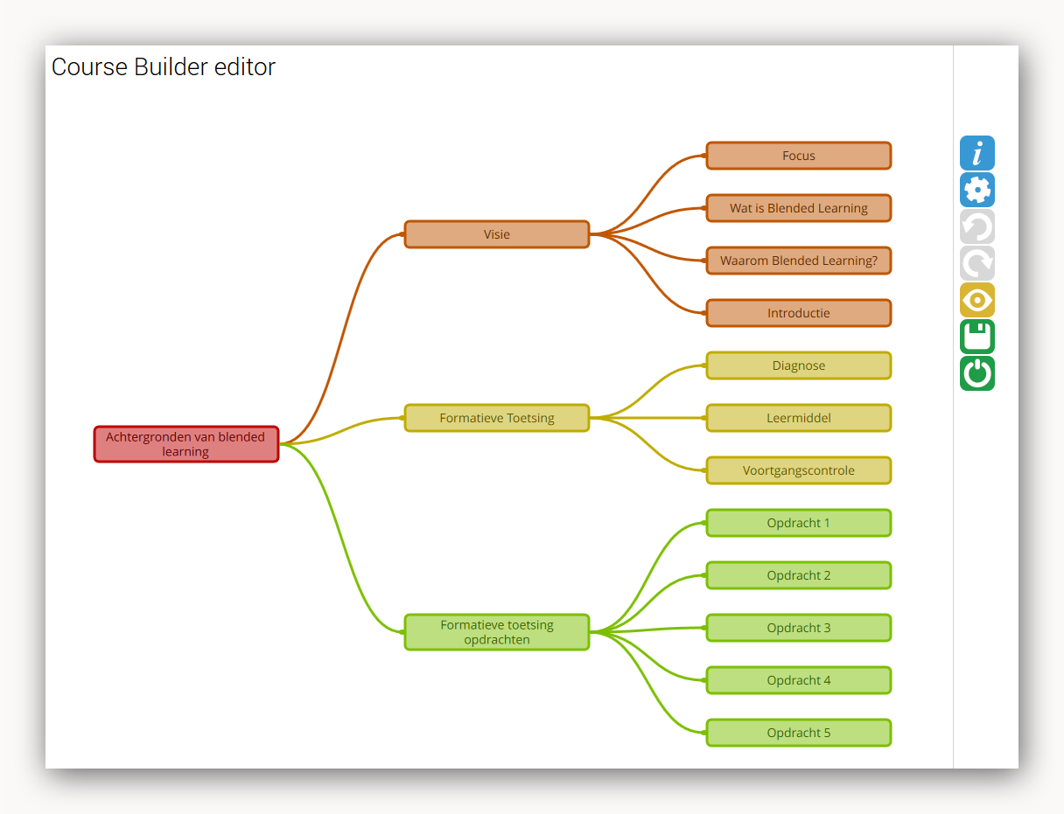
Course builder

Slide 15
Dashboard

Slide 16
Content

Slide 17
Social context

Slide 18
Social context

Slide 19
Social context

Slide 20
Bench marking

Slide 21
Co-operative learning

Slide 22
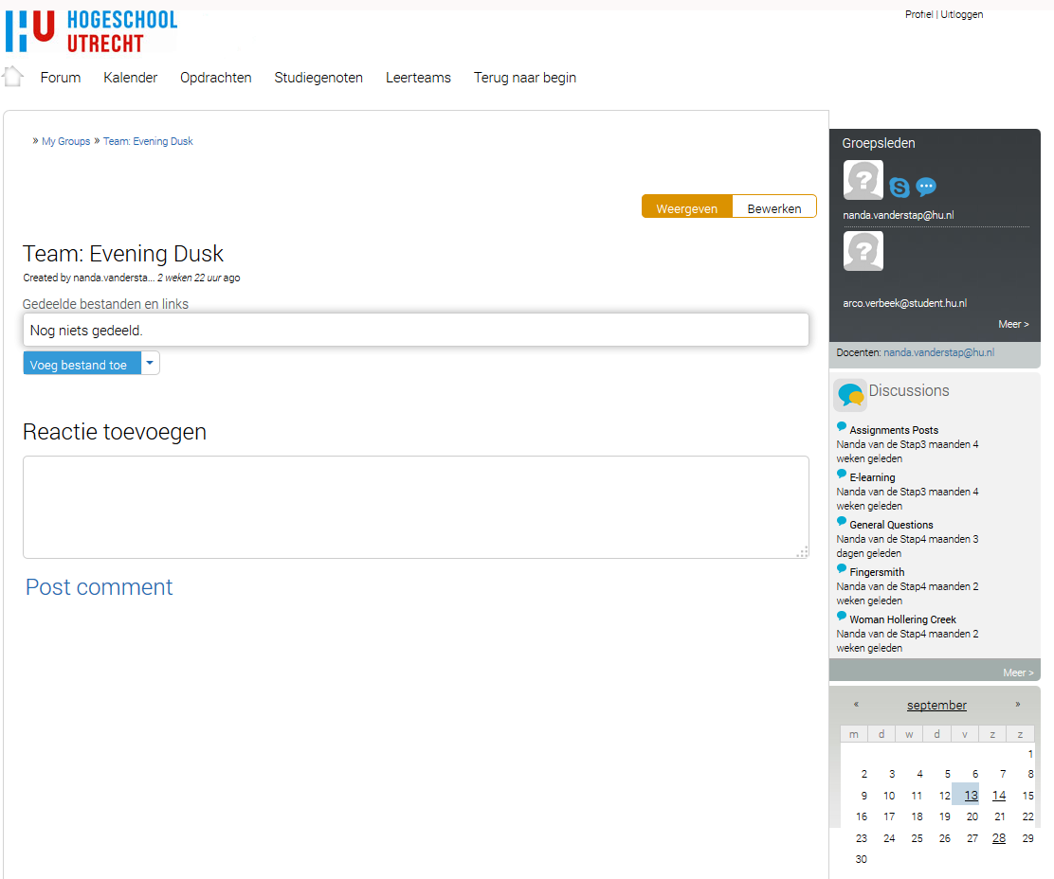
Co-operative learning

Slide 23
Integration of digital tools

Slide 24
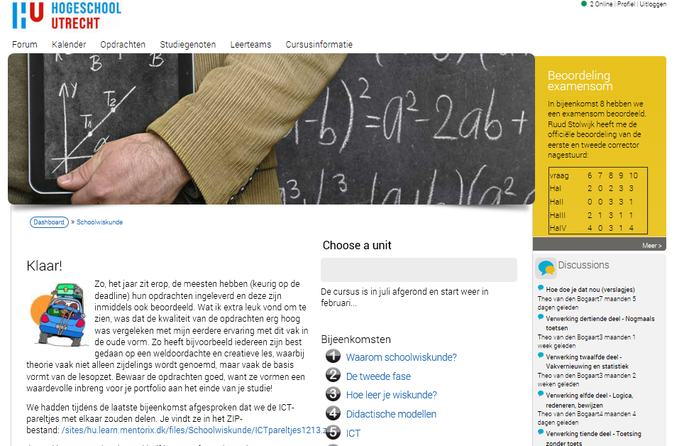
The reality

Slide 25
Questions?
Hans van Bergen
hans.vanbergen@hu.nl

